Slide 1
Announcements
Last day to turn in labs is Monday
Unless you talk to me about doing a makeup lab on either Tuesday 28th or Wednesday 29th
Currently have plans for a Tuesday Day session (3:30) and a Tuesday Night session (7:30)
I need to know in advance which labs to set up - so email me if you need a makeup lab
Course evaluations are now open - check your ASU email
Minor error on question 6 of the pre-lab - I will manually regrade it
This is our last lab!

Slide 2
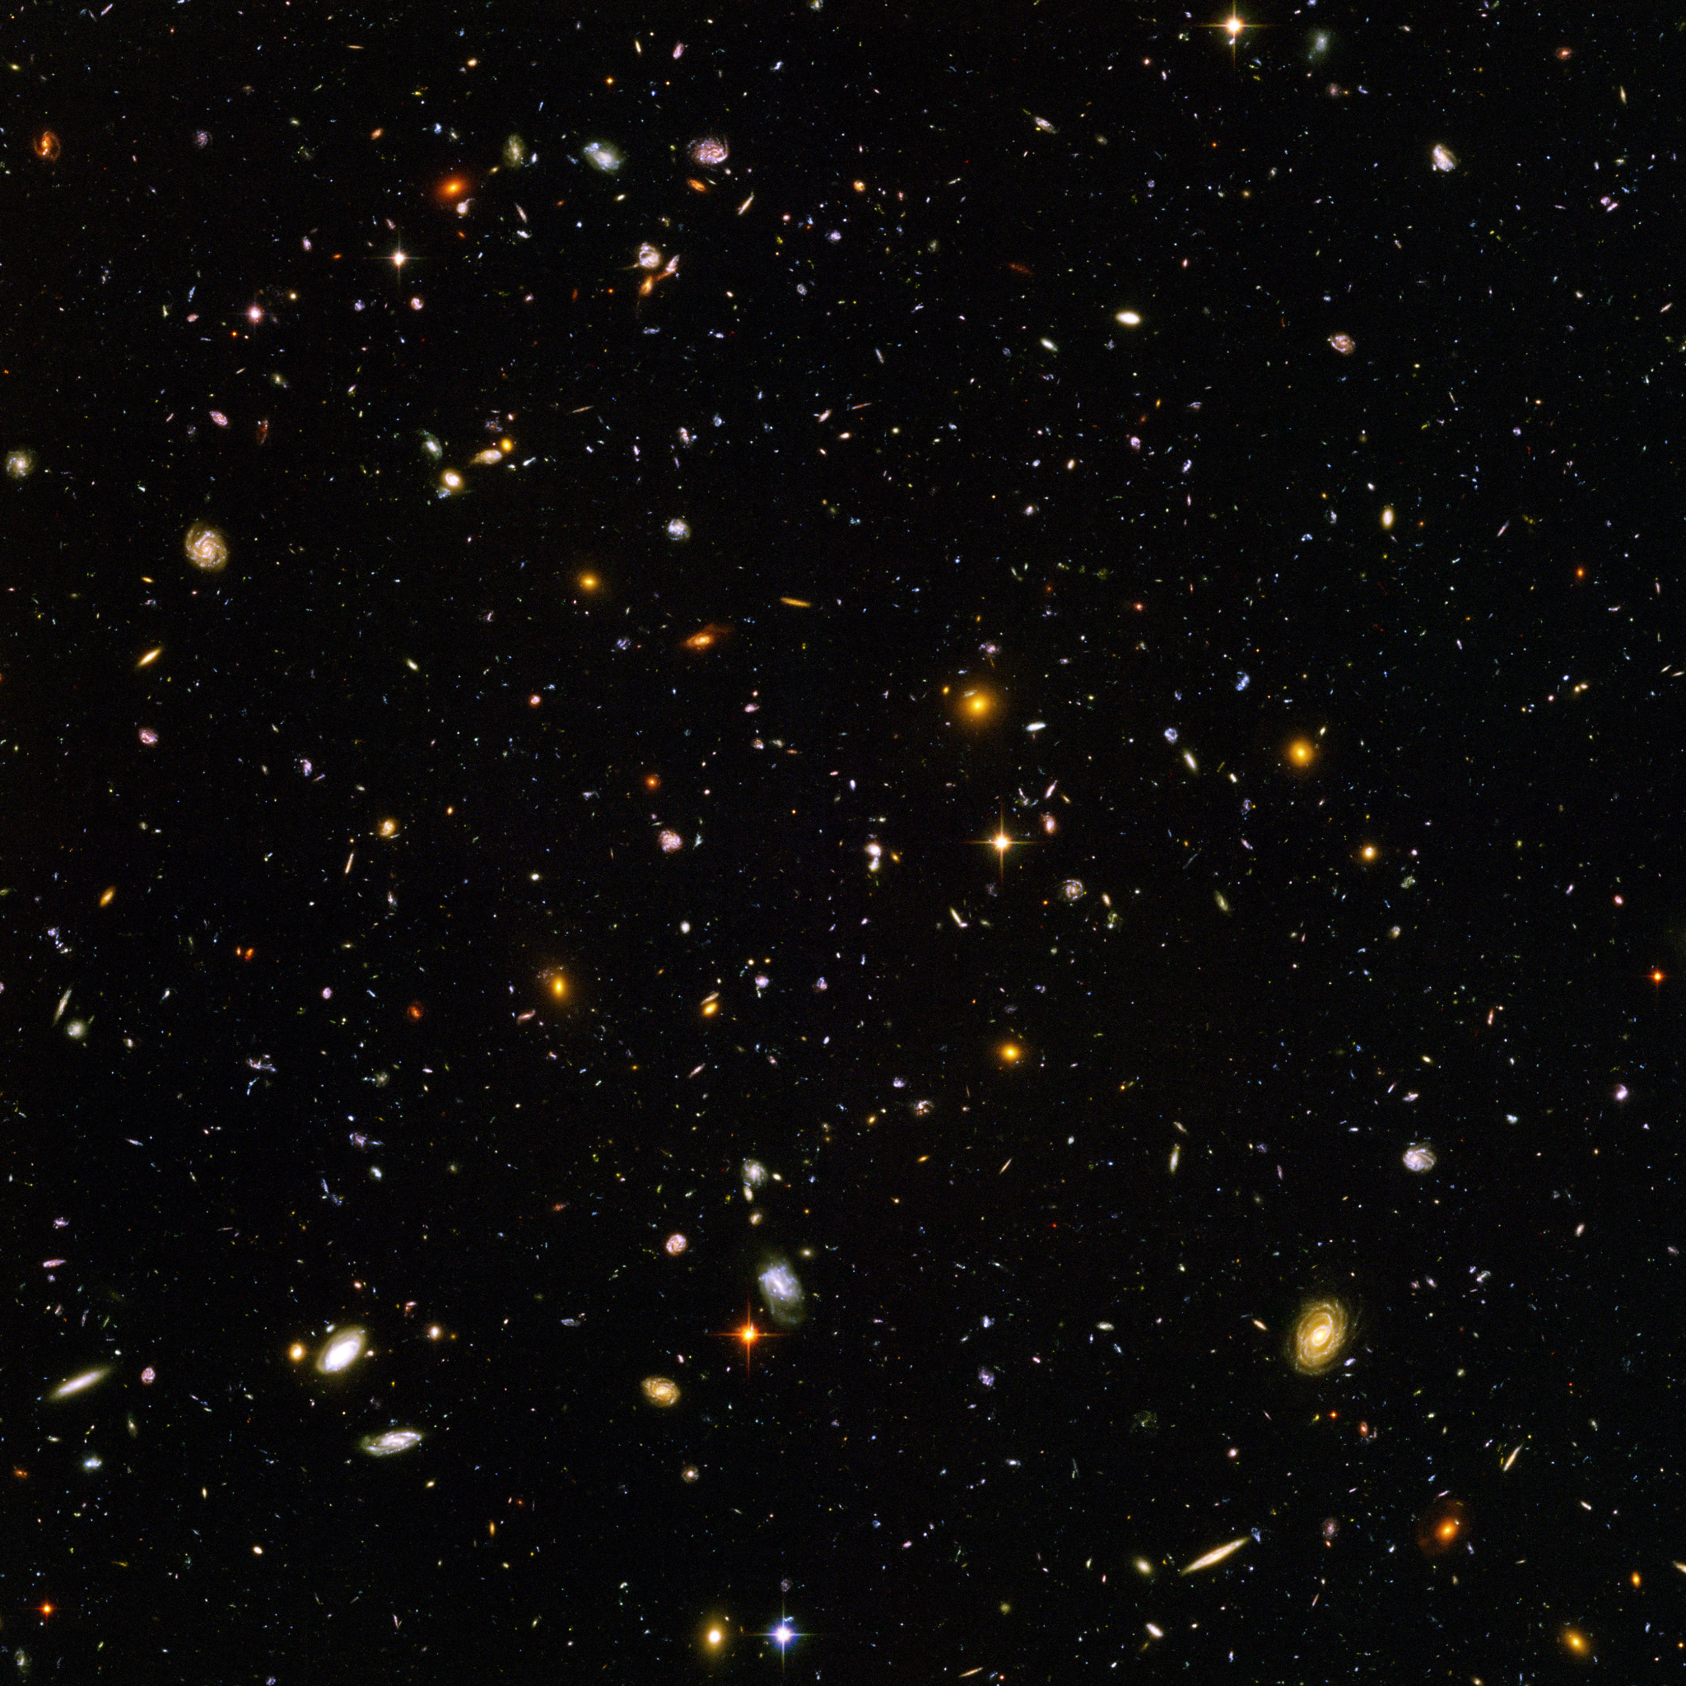
Hubble Expansion

Slide 3
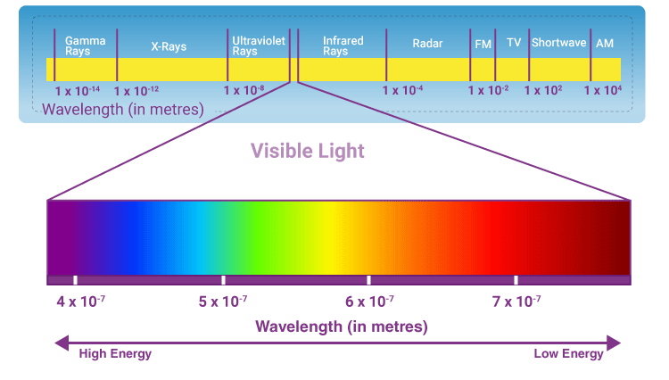
Colors and Wavelength Review
Light is a wave
The wavelength (distance between the crests of two individual waves) determines the color of the light
Long wavelength (low frequency) means redder light
Short wavelength (high frequency) means bluer light

Slide 4
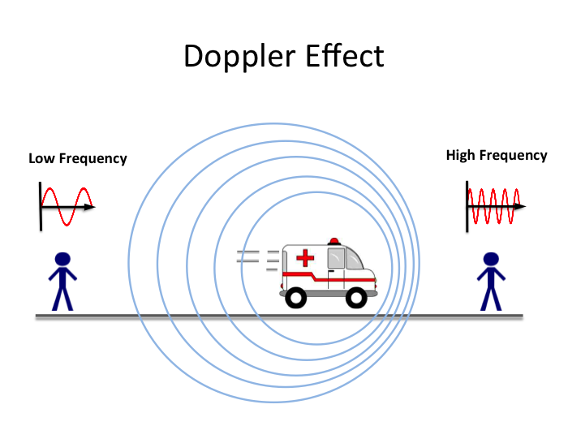
Doppler Shift
Imagine an emergency vehicle driving past with its sirens on
As it gets closer, the sound is a higher frequency
But once it passes you and starts moving away, the sound has a lower frequency
The sound at the source doesn’t change - but it gets squished as the source comes towards you and stretched as it moves away

Slide 5
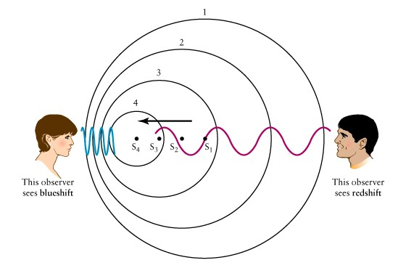
Doppler Shift Cont.
The same thing happens with light
We call this blueshift when the light source is moving towards you
Squishing the waves, so they have a shorter wavelength and appear more blue
And Redshift when the light source is moving away
Stretching the waves, so they have longer wavelengths and appear more red

Slide 6
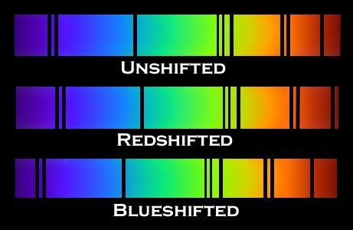
Doppler Shift Cont.
So how do we find Doppler Shift?
Remember from the Spectroscopy Lab, each element has specific spectral lines that appear at certain points where they absorb or emit light
Those lines shift along with the light
They become more blue when the light is blueshifted
And they become more red when the light is redshifted
In other words, we know where the lines should be based on laboratory experiments, so we can the difference to see how much shift there is

Slide 7


Doppler Shift Cont.
The faster something is moving, the more shift we observe
So, once we know how much the light is shifted, and in which direction, we can calculate how fast the light source is moving towards or away from us
Or if z << 1

Slide 8
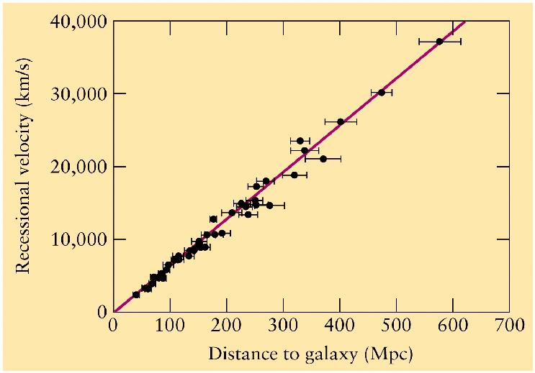
Hubble’s Law
When Edwin Hubble studied the spectra of distant galaxies, he expected that the number of redshifted galaxies and blueshifted galaxies would be roughly the same
But they weren’t, the vast majority of galaxies were redshifted
And the amount of redshift increased the further away the galaxies were - indicating they were all moving away from us

Slide 9
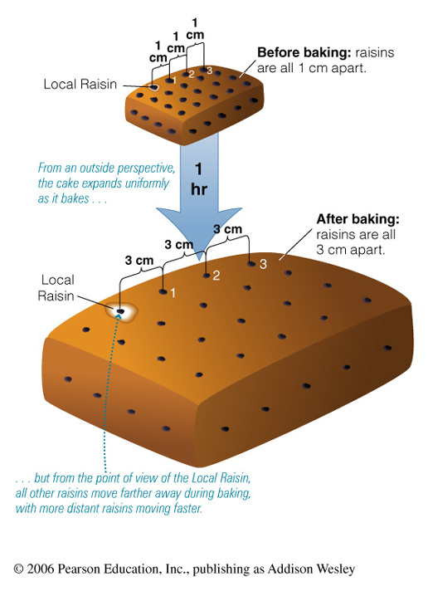
The Expanding Universe
So the universe is expanding around us, but we are not at the center
Space itself expands everywhere, in all directions
Think of a cake baking, or a balloon being blown up

Slide 10
Hubble’s Law Cont.
When you graph the velocity of galaxies vs their distance from us, you will see a line
The slope of this line is “Hubble’s Constant”
H0 = v (km/s) / D (Mpc)
This represents how fast the universe is expanding

Slide 11

Hubble’s Constant and the Age of the Universe
The units of Hubble’s Constant are km/s/Mpc
Both km and Mpc are distances, and since they are being divided they can cancel out
This will leave you with just a number of 1/s (a.k.a. Hz (or Bq))
Take the inverse of this (divide 1 by it) and you will have a number of seconds - this is the age of the universe
Because Hubble’s Constant is a measure of how fast the universe is expanding, this is like turning back the clock to see how long ago was all the stuff in the universe all in the same place (a.k.a. The Big Bang)

Slide 12
Today
You will use the AHaH software to observe various galaxies in the Hubble Ultra Deep Field
Make a copy of the spreadsheet linked on Canvas and input redshift and distance measurements of 15 galaxies (with redshift less than 1.0)
It will calculate the velocity and plot the galaxies on a graph automatically
Answer the questions based on the calculations and graph
You will effectively be finding Hubble’s Constant for yourselves, and then using it to estimate the age of the universe

